Slide 1
IPv6 at CiscoLive 2013 behind the scenes
Daryl Tanner – Virgin Media
Andrew Yourtchenko - Cisco

Slide 2
What a typical CiscoLive Europe network looks like
Lots of gear
  ~ 2-4 core switches (usually 6500)
  ~ 15-20 distribution switches
  ~ 200-250 access switches
  ~ 250-300 Access Points
  ~ 4-6 Wireless LAN Controllers
  … a lot of other pingable things
Quick build, short lifespan: 4 days build; 1 week online, 1 day teardown
IPv6 on wired is “easy” – main focus is on wireless: attendees.
  Usual count in Europe is ~3000 simultaneous online devices at peak

Slide 3
IPv6 comes from your ISP…

Slide 4
The challenge
Virgin Media were asked in mid-October 12 if we could provide native IPv6 for Cisco Live 2013
At the time we had
  An IPv6 address allocation from RIPE 
  no IPv6 transit in place 
  IPv6 was ‘not allowed’ on the network 
  Testing not completed 
  A ‘No’ from Security team 
  No operational support 

Slide 5
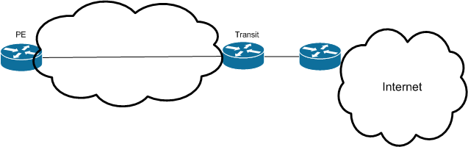

IPv4
IPv4
L2
L2
IPv6
IPv6
London
ExCel
Transit
Notes:
0. A fairly standard IPv4 Internet Access Service. This was already in place as it’s a service we provide to London ExCel
Could not overlay IPv6 onto the existing circuit, so we would need some additional hardware:
A dedicated IPv6 transit link from a transit providers
A separate, dedicated transit router
A CPE router at London ExCel
Whilst I wasn’t allowed to put IPv6 across the network, I could use layer 2. So, one from the transit provider to the ‘new’ transit router,
And one from the Transit router to PoP. ‘Spare’ fibre to ExCel
The rest was plain sailing – Just set up the BGP peering with the ‘outside world’
And allocate an address block for Cisco Live.
And there it was – end-to-end native IPv6-only.
5

Slide 6
The solution
Dedicated IPv6-only transit router
  Installed on 6th December
  IPv4 for management
Isolated transit link
  Ge fibre
  IPv6 /32 advertised via BGP
  Cross-connect installed on 2nd January
Assortment of internal connections / configurations
  Numerous people involved in the physical and logical connections
  Borrowed an ‘unused’ fibre into ExCel London
Cisco ASR1002 Access router
  Received on 13th December to configure and test
  Moved to ExCel London on 18th January
Ready for service – with one week spare

Slide 7
Meanwhile, downstream…

Slide 8
CiscoLive 2012 IPv6 WiFi recap
WiFi on 7.2 code (“official” IPv6 support)
Discovered iOS aggressively creating new temp IPv6 address
Temporary workaround: set very short lifetimes for the binding table
  Required very short prefix lifetimes
  Necessary to send RAs more frequently
  Probably created more problems than solved
Long-term solution in the code: change the binding table management

Slide 9
IPv6 privacy addresses demo

Slide 10

iOS privacy address demo

Slide 11
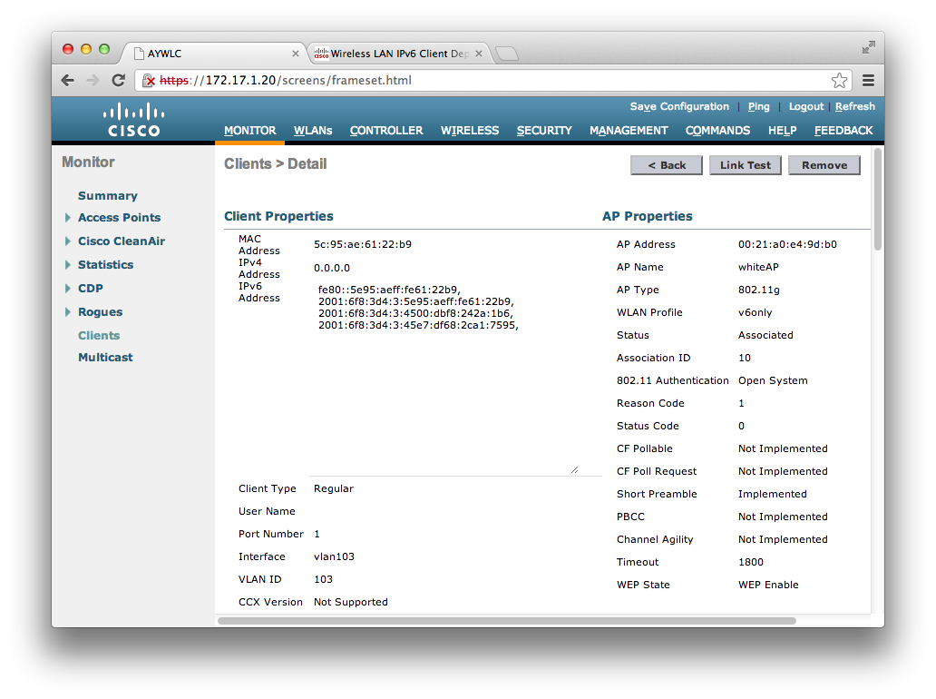
WLC 7.3 FHS source-guard + iOS =

Slide 12
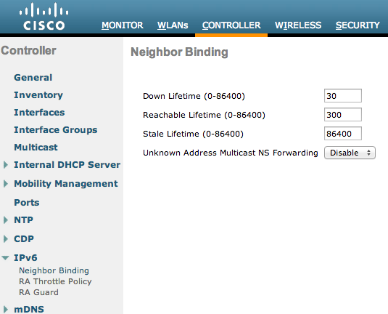
Neighbor Binding table in 7.3: the defaults work !

Slide 13
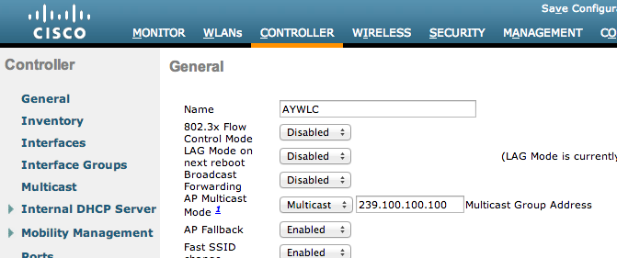
Operational consideration: mcast IPv6 ➔ Multicast CAPWAP
Ensure your CAPWAP-carrying infrastructure has IPv4 multicast routing configured properly !

Slide 14
SSM: simplest way to ensure multicast routing
ip pim rp-address 10.127.0.254
ip pim ssm default
interface Vlan7
Description SER203-00-ACCESS-POINTS
ip address 10.7.3.1 255.255.255.0
ip helper-address 10.6.1.6
ip helper-address 10.6.2.6
no ip redirects
no ip unreachables
no ip proxy-arp
ip verify unicast source reachable-via rx
no ip route-cache
ip pim sparse-mode
ip igmp version 3
ip igmp limit 500
ip ospf network point-to-point
ip ospf 1 area 0
ipv6 address 2A02:88FE:DE30:0703::1/64
no ipv6 redirects
no ipv6 unreachables
ipv6 verify unicast source reachable-via rx
ipv6 ospf network point-to-point
ipv6 ospf 1 area 0
no shutdown
!
“ip pim ssm default”
Use SSM default range 232.x.x.x in WLC for multicast group address

Slide 15
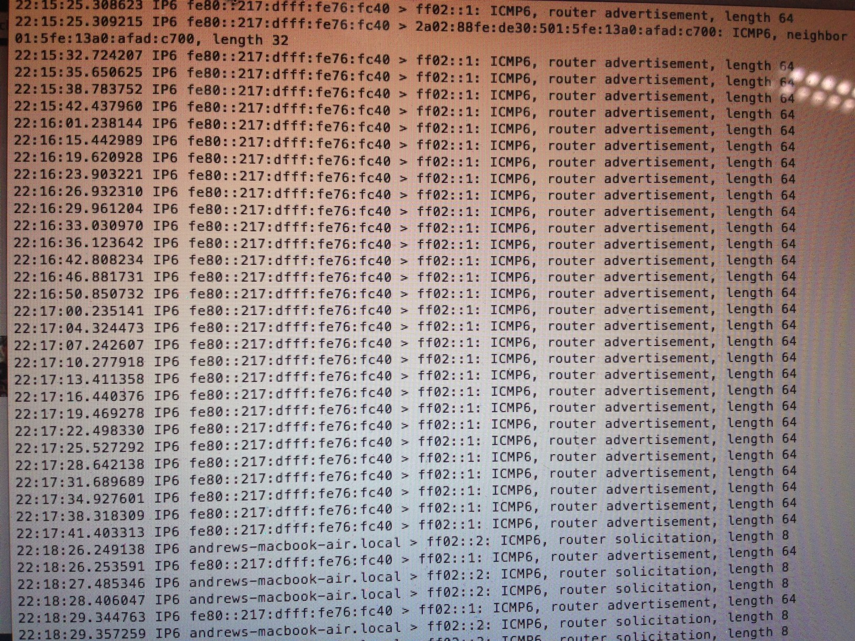
Too much of IPv6: multicast solicited RAs

Slide 16
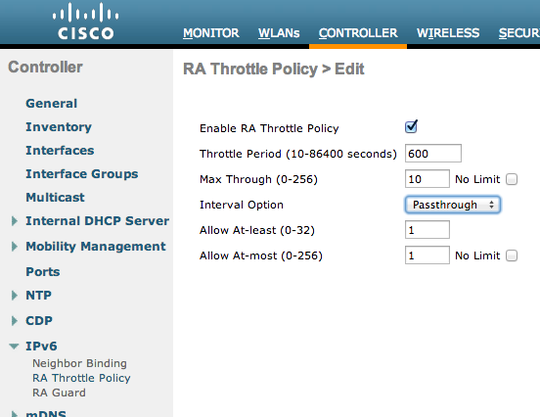
Multicast RA throttling

Slide 17
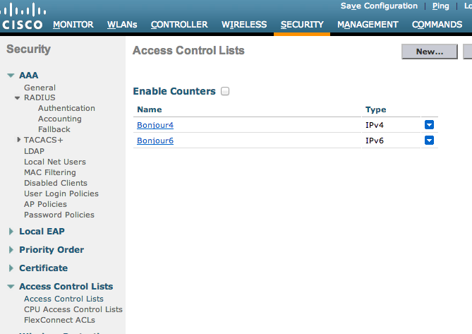
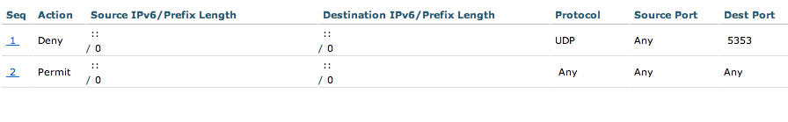
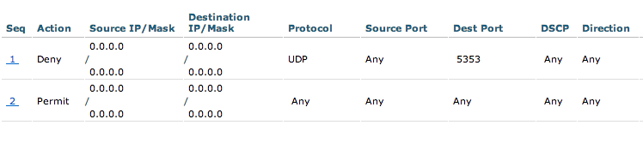
Bonjour: great in a small network, tough in a large network

Slide 18
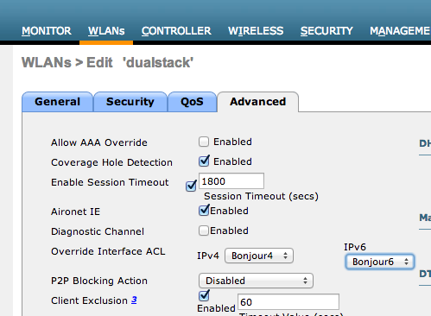
Applying the ACLs for Bonjour

Slide 19
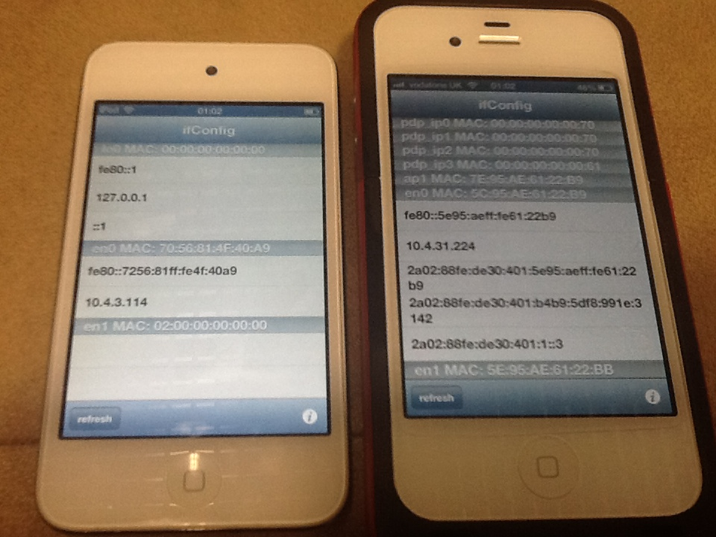
Endpoints sometimes do not act consistently
Both devices are on the same BSSID (i.e. same AP)
iPod started to work correctly after reboot.

Slide 20
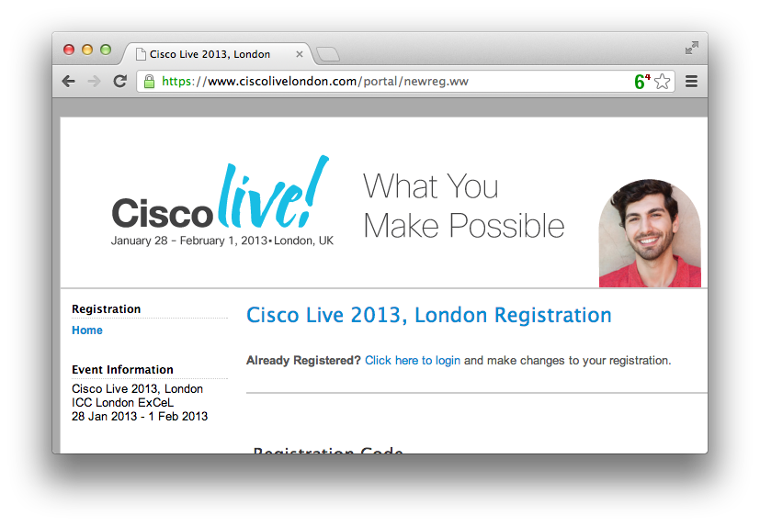
Wired IPv6 is easy: onsite ciscolivelondon.com dualstacked

Slide 21
“Out of 22,149 unique IP addresses that have hit www.ciscolivelondon.com since Sunday. 9,794 have been IPv6 addresses. 249 of those have been addresses external to the venue network.”
Jason Williams
ciscolivelondon.com team

Slide 22
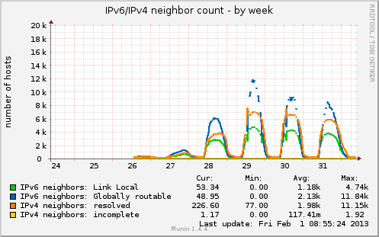
11.15K Entries in the ARP cache, 11.84K global IPv6 addresses ?

Slide 23
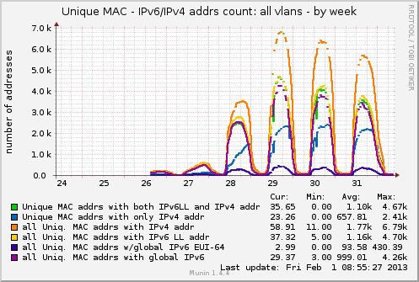
Peak: 4.67K unique MAC addresses in the ND cache

Slide 24
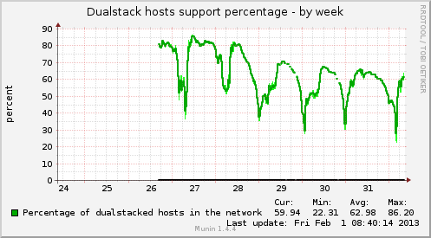
~65% peak of dualstack hosts during the show

Slide 25
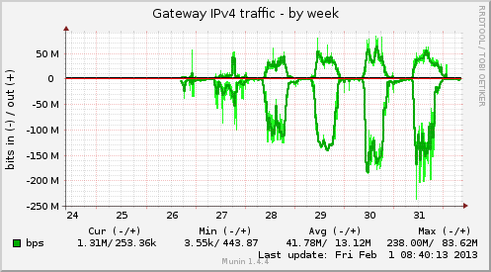
Traffic stats: http://stats.ciscolive-ipv6.com/

Slide 26
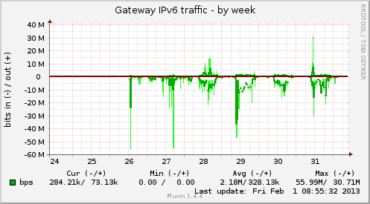
Traffic stats: IPv6 on average ~5% of IPv4 traffic; 45Mbps peak

Slide 27
Conclusions
IPv6 works
The earlier you act – the more experience you get
  Both for your employer and for yourself as a professional
Image credit: Image credit: <a href='http://www.123rf.com/photo_14477171_chicken-and-an-egg-shell-on-white-background.html

