Slide 1
Database Update
Kaveh Ranjbar
Database Department Manager, RIPE NCC
Notes:
Good morning, My name is Kaveh Ranjbar and I am Manager of the RIPE Database Department, In this presentation I am going to provide a quick update on what we did between RIPE 65 and this meeting in the database department as well as an outlook on our major focus areas in the coming months. Wilfried will moderate the session and mikes will be open after the presentation for questions and comments

Slide 2
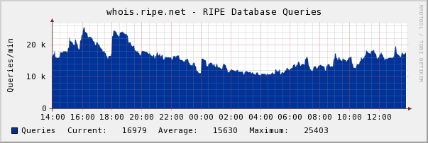
RIPE Database statistics
Operational stats:
https://www.ripe.net/data-tools/stats/ripe-database
Notes:
I will keep this presentation very quick, There are 5 of us in the database team
We develop and maintain the database core and all of the tools around it
We have an average of 22 thousand Queries per minute which is close to a billion queries per month, 1.6% of them IPv6
IPV4 & V6 queries, sync updates & mail updates had a combined uptime of more than 99.90% over past 6 months, for the queries, the number is very close to 100%. The code was hot deployed and we had no downtime because of switching to new code or deploying new releases. Detailed stats from new code will be live soon. No major Reachability issues reported, atlas data present not yet consolidated

Slide 3
On reporting issues and change mgmt
Full transparency, everything is announced on:
http://www.ripe.net/lir-services/service-announcements
Public release notes are available at:
https://www.ripe.net/data-tools/db/release-notes
Issues with significant impact on our users are always announced on mailing lists
Notes:
Db-wg and ncc-announce if required

Slide 4
Progress
What we did?

Slide 5
Redevelopment of Whois
Redevelopment of whois backend was finished on Q1 2013
All RIPE Database operations are handled by new software, old platform is fully decommissioned
New system has helped us to deploy a fault tolerant and easy to maintain infrastructure

Slide 6
New whois benefits
Fast, simple and a lot more flexible
Changes and new features are implemented much faster
Well tested code, provides quick feedback on possible impact of any change
Verbose logging, live management
Simple hardware, easy to deploy, no special dependency, easy failover and easy to scale
Notes:
Authentication
Syntax Checking
Business Rules
Error Handling and Reporting
Data Presentation

Slide 7
Example infrastructure change - BEFORE

Slide 8
Example infrastructure change - AFTER

Slide 9
Integrated system
No hacks! The system runs as a configurable, single entity
We have been able to easily automate complex processes like reclaim functionality
Proper management and reporting API (internal)
Hot deployment to cluster with no downtime, implementing long options along with deployment took half a day for one engineer

Slide 10
Open source
Code is available at:
https://www.github.com/RIPE-NCC/whois
BSD License, easy to install and change
229K lines of code, 139K of it are tests!
No dependencies, no container:
Java runtime and MySQL to run
Java SDK, MySQL, git and maven to build
Proposing to provide Drop-in VM

Slide 11
Action Items
Denis Walker
Database Business Analyst, RIPE NCC
Notes:
Now I will give you our business analyst Denis Walker who will present a quick update about our progress on action items from RIPE 65. As a note we were sending progress updates every two months to working group chairs.

Slide 12
AP65.1: ORG Object changes
With the new code in place NCC proposed changes were not required:
All resource objects already have an ORG Reference:
PA Objects have the LIR ORG on them
PI Objects have (or will have) LIR or ENDUSER organisation object on them
Same model is used for abuse-c implementation
With tagging it can even improve!
Policy proposal to add sponsoring ORG

Slide 13
AP65.2: Raise interest in Geo Location
Alex Band

Slide 14
AP65.3: Personal data in Object History
DB Service is in Beta (more details on further slides)
No personal data objects (person/role) are returned through the service
Legal department cleared the service
No deleted objects shown, should we show them?

Slide 15
AP65.4: Document 2011-06 before impl.
Implementation plan and impact analysis published on:
https://labs.ripe.net/Members/kranjbar/implementation-details-of-policy-2011-06
Detailed explanation published on:
https://labs.ripe.net/Members/denis/creating-and-finding-abuse-contacts-in-the-ripe-database
Announcements were sent to ncc-announce, ncc-services, db-wg and anti-abuse-wg
Now in service with an already good utilisation: 25% of v4 allocations (35.8% in total alloc. size)
Notes:
-------- NETWORK NUMBERS:
Total Number of v4 allocations listed: 20,567
Number of v4 allocations covered with abuse-c: 5,150 or 25 % of v4 allocations
Total Number of v4 PI assignments listed: 28,673
Number of v4 PI assignments covered with abuse-c: 613 or 2% of v4 assignments
Total Number of v6 allocations listed: 5,637
Number of v6 allocations covered with abuse-c: 1,345 or 23.8% of v6 allocations
Total Number of v6 assignments: 1,394
Number of v6 assignments covered with abuse-c: 69 or 4.9% of v6 assignments
Total Number of objects: 56,271 (IPv4: 49240 IPv6: 7031)
Number of objects covered with abuse-c: 7,177 or 12.7% (IPv4: 11.7% IPv6: 20%)
-------- IPv4 NETWORK SIZES:
Total size of v4 allocation listed: 594,488,320
Size of v4 allocations covered with abuse-c: 213,399,552 or 35.8%
Total size of v4 PI assigned listed: 169,759,288
Size of v4 PI assigned covered with abuse-c: 4,544,448 or 2.6%
Total size of listed v4 addresses: 764,247,608
Size of listed v4 addressed covered with abuse-c: 217,944,000 or 28.5%

Slide 16
On Goings
What we are working on

Slide 17
API
We have re-developed the API code
Backward compatible, but queries are handled directly from whois core instead of parsing RPSL results
Much faster
More consistent and is for all services
Streaming of results
Self documenting

Slide 18
History of objects
Useful for change management, recovery, investigation and research
Was released in April as beta
History of all objects (except person and role) are available with a query option
Available through API and WEB as well as port 43

Slide 19
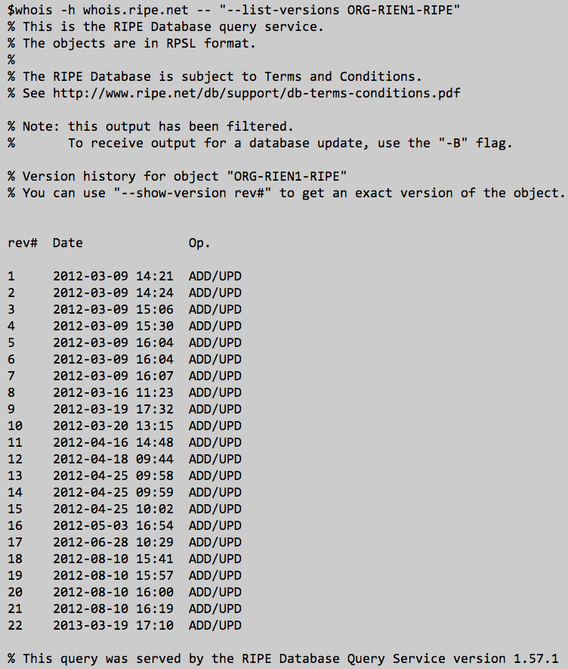
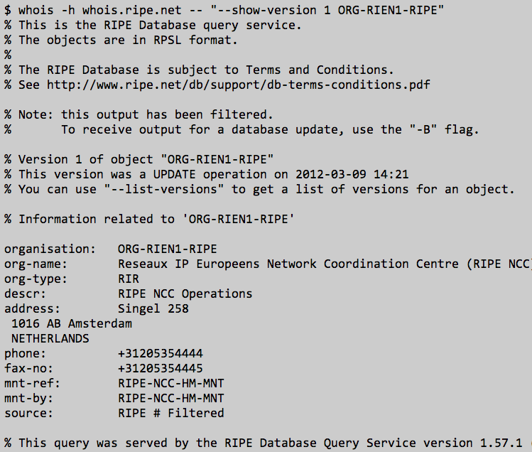
Example History Query

Slide 20
Proposal: Improvements on Dummification
We currently remove all personal data from nightly dumps using a ‘greedy’ approach
But we also remove all links between the objects
And data was replaced with static values
Made it useless for researchers
New proposal: Making the dummification algorithm more smart
Keep parts of phone numbers, email addresses and addresses visible while maintaining the links
https://labs.ripe.net/Members/kranjbar/proposed-improvements-to-dummification-of-personal-data-in-the-ripe-database
Notes:
Early implementation of data protection was heavily on the cautious side
After more community discussions and better understanding of the balance between privacy and data usage for public data we have revised the process

Slide 21
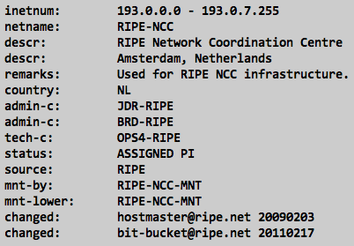
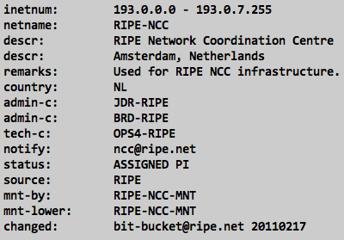
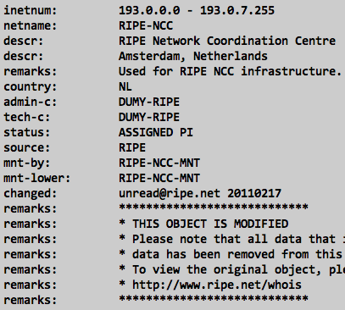
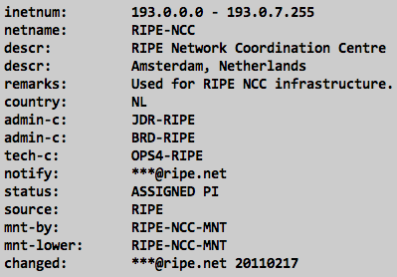
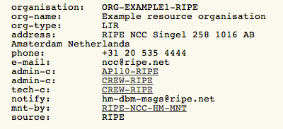
Example Dummification
Current Structure
Proposed Structure

Slide 22
Proposal: Tags
New proposal to optionally provide operational metadata along with updates
System will tag resources, for example all RIPE Region resources as %RIPE_Region
Results can be filtered based on tags
Can be extended to cover any other service, objects marked for automatic cleanup, lameness check results, assisted registry check markers, etc.
Very useful for data clean up
No change to existing behavior

Slide 23
Vision
Longer term plans and ideas for improving the RIPE Database

Slide 24
Plan: Unref. Object Automatic Cleanup
Person/Role/Maintainer/Key-cert/ORG objects with no reference will be automatically deleted after 90 days
a TAG will show users if an object is a candidate for automatic cleanup and when
Next step is to look into cluster of objects -ROLE referring a PERSON and same MNTNER – no other references to these three objects

Slide 25
Proposal: Placeholder cleanup
A lot of placeholder objects with no real benefit (e.g. 0/0 and AS-BLOCKS) except for internal software consistency
With proper tagging and authorisation business rules we can remove all of them
We already import all other RIR public data, now we tag the data based on their published “stat” file
All resources, globally, allocated/assigned are tagged
Database search (with --all-sources option) will show proper matches without placeholders clutter

Slide 26
Idea: RIPE Easy Whois
Simple to use web interface for searching on resources
Will always show single results, with clear indication of which RIR is responsible for a resource and who is the data maintainer
Will provide data in easy to understand form, RPSL data will be available with a single click
Clear indication of responsible entities for each piece of data

Slide 27
Proposal: Route object cleanup proposal
Changing the Auth. requirements for ROUTE object from IP Address holder AND ASN holder to only IP address holder
Route statement says this network MIGHT be advertised from that ASN
Why do we need the ASN to auth. that?
Same behavior already exists in ROA creation, only IP address holder needs to authorise
Will help improve usability

Slide 28
Idea: Single Sign On Integration
Will be backwards compatible
New auth type in maintainer:
auth: SSO sso_registered_email
Should work both ways, maintain SSO access for a maintainer from RIPE Access control panel or by editing the maintainer object
Added value for web tools, will provide a maintainer based view on web updates

Slide 29
Plan: Documentation
We are working on streamlining DB Documentation and RIPE Database’s webpages
Easy to read, short and concise set of documentation in only three document sets:
Accessing Data
Updating Data
Developer Documentation
Will always be linked to a version of the code
Work with TS to produce additional material

Slide 30
Questions?

