Slide 1
On the Suitability of ping to Measure Latency
Cristel Pelsser <cristel@iij.ad.jp>
Luca Cittadini <luca.cittadini@gmail.com>
Stefano Vissicchio <stefano.vissicchio@uclouvain.be>
Randy Bush <randy@psg.com>

Slide 2
We Use Ping
But, what is the actual distribution of the RTTs?
Could there be a rich distribution?
We were using Atlas and found ping variance to be unexpectedly high
So we decided to calibrate our tools
So we ran a paris traceroute series from Roma Tre to Ashburn

Slide 3
Paris Traceroute Uses
Flow-ID
To Explore Hashed
ECMP / LAGged
Alternative Paths

Slide 4
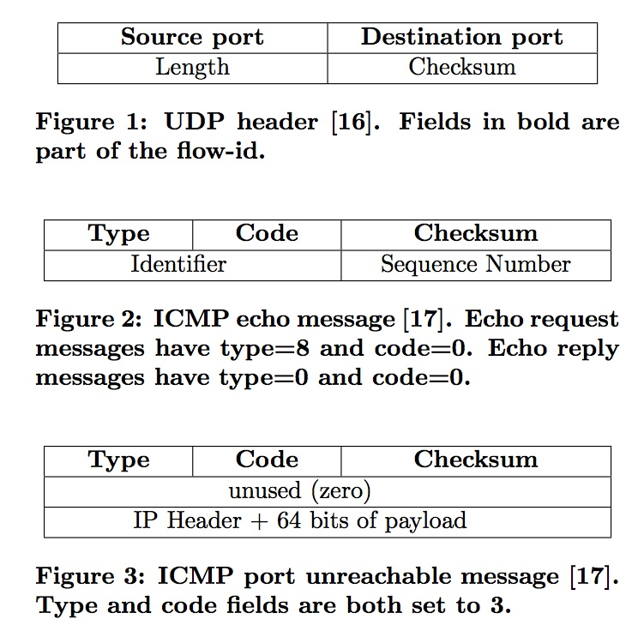

Slide 5
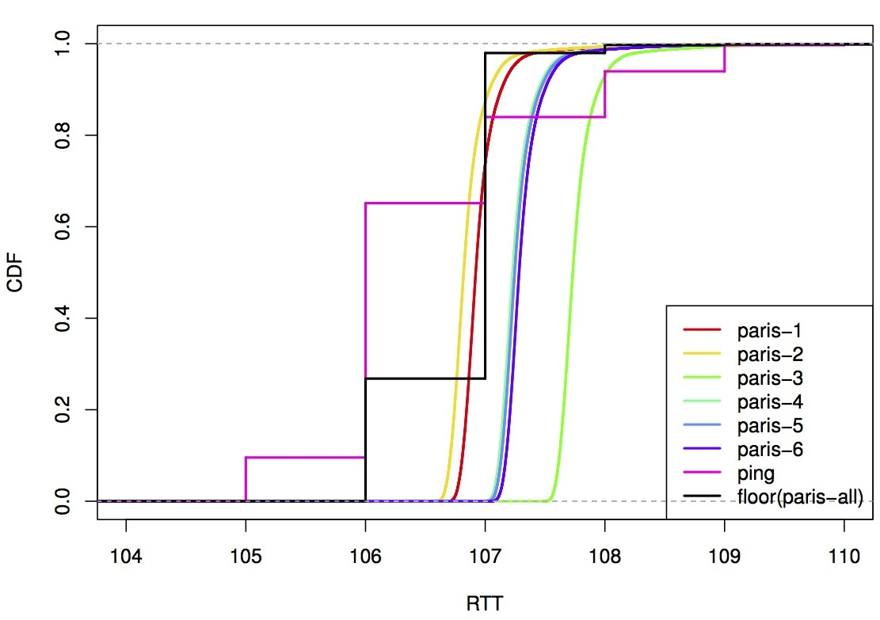
Roma Tre - Ashburn
Notice Linux Rounding

Slide 6
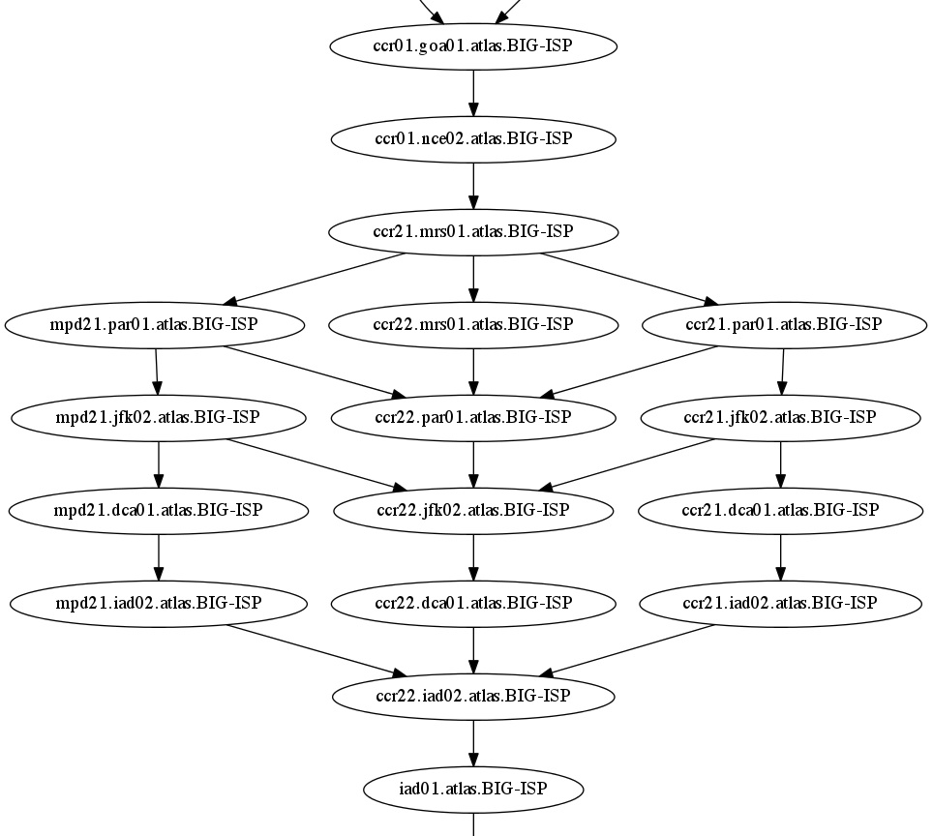
ECMP
!= Equal Latency Multi-Path

Slide 7

So, A Simple Path
Single Layer Three Path
Dallas
Ashburn

Slide 8
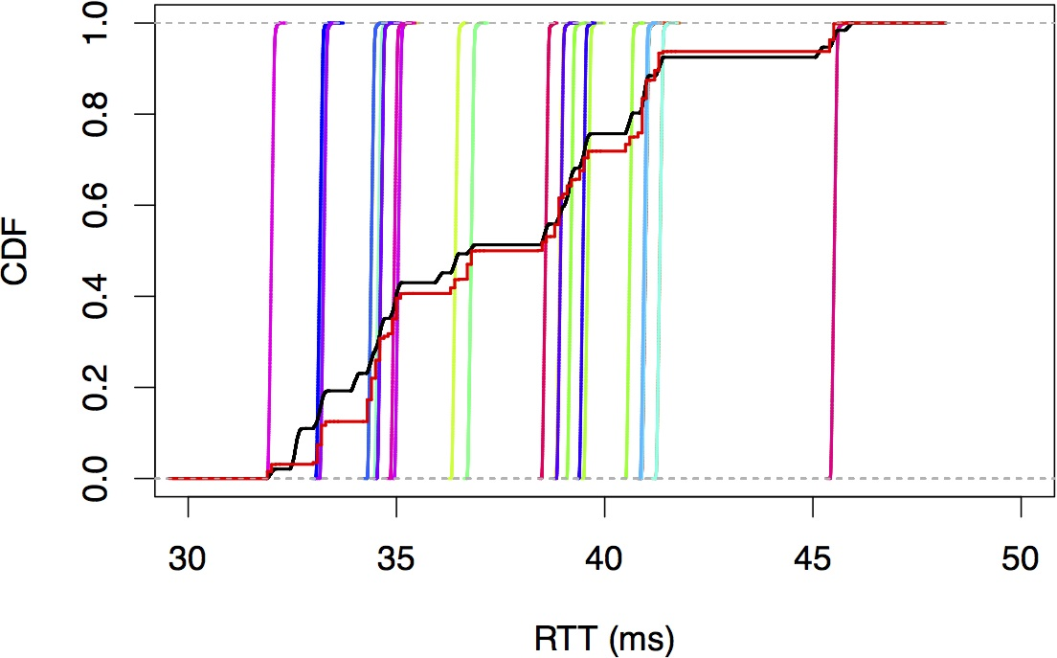
Simple Path Used LAG
FreeBSD Not Rounding

Slide 9
Looking for Causes
Very Reproducible
Circuit Loading <= 50%
Same different times of day
Same different probe timing/spacing
Same UDP or ICMP
Layer > 3 Hashing => Large Effect

Slide 10
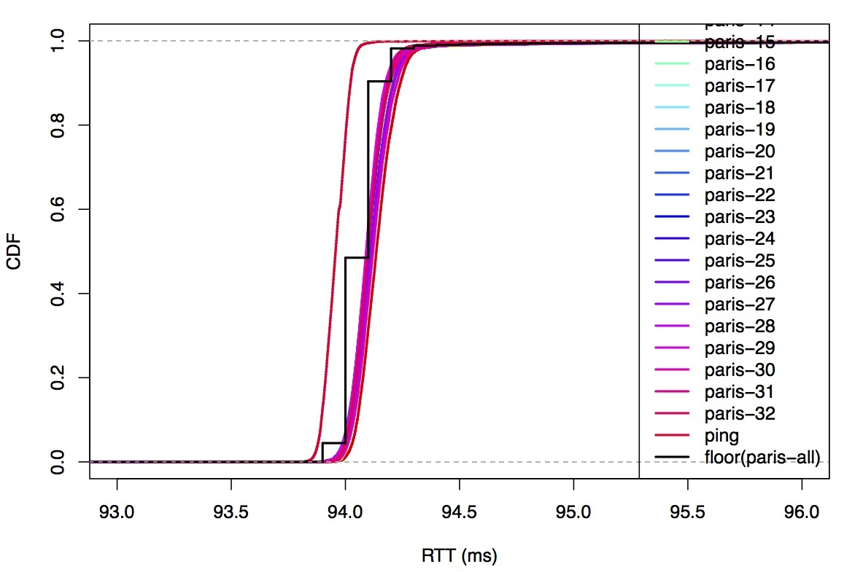
Layer-3 Only Hash

Slide 11
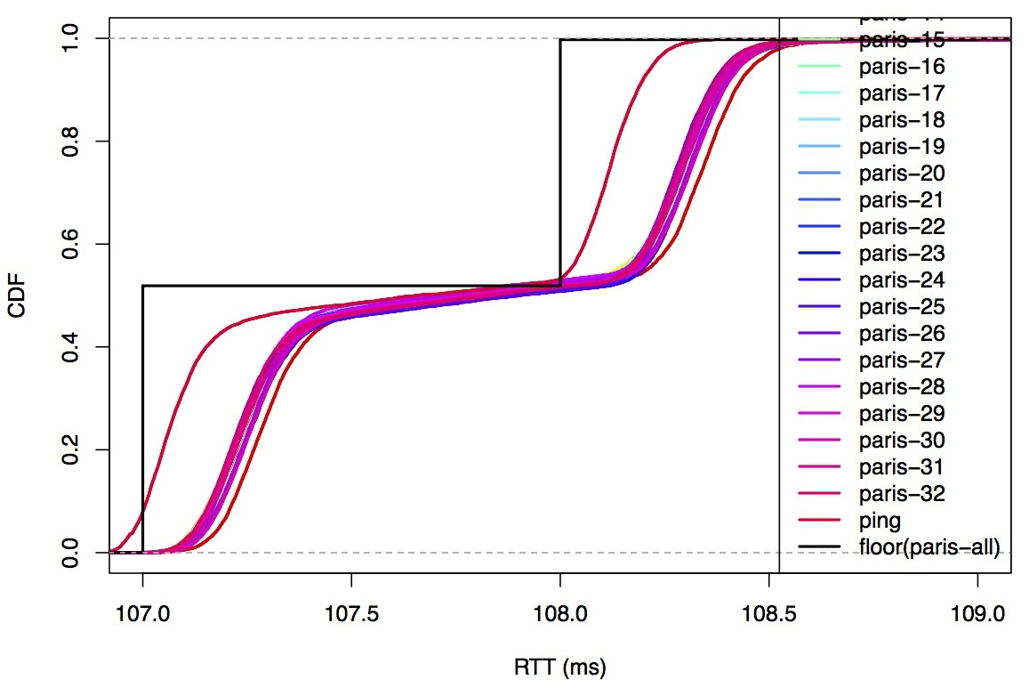
Event During Run

Slide 12
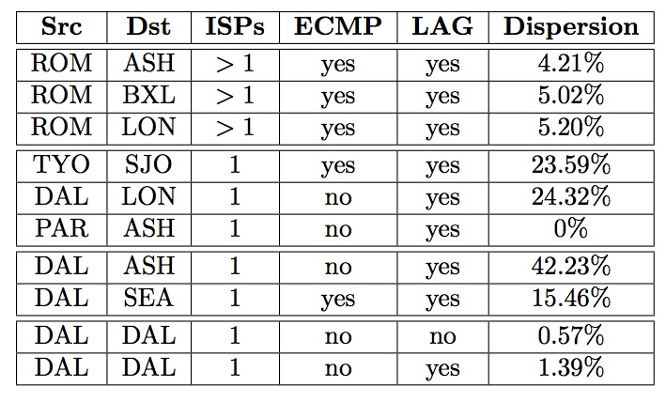
Selected Summary

