Slide 1
Save Money Online Without Killing Yourself. Fake pharmacy websites selling fake medicines. So What!
Michele Neylon

Slide 2
Who am I?
Michele Neylon
Founder / CEO Blacknight
http://mneylon.tel
- @mneylon
http://michele.me/blog
http://www.blacknight.co
On most other social networks ..

Slide 3
Welcome to the Information Super-highway

Slide 4
Feeling Sick? The internet has everything right?

Slide 5
Go Online – Great Bargain

Slide 6
Prescription Drugs Bargain Price?

Slide 7
The Facts…
97% of websites offering to sell medicines are illegitimate

Slide 8
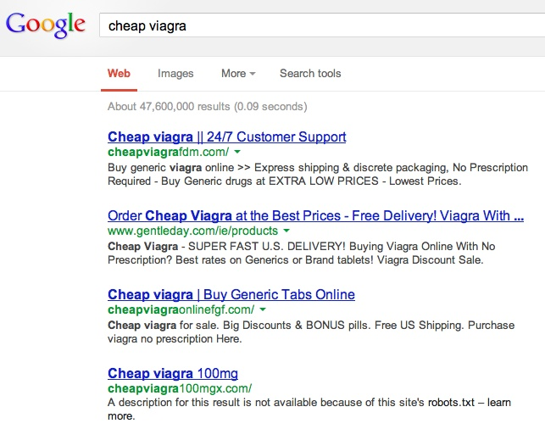

Slide 9
Online Pharmacies in the EU
Only some Member States allow online sales of OTC and prescription-only medicines
Others allow online sales of OTCs only, while the majority still prohibit both

Slide 10
Happy Pills!!!

Slide 12
The Facts…
(Rx) medicines sold online that hide their physical address are counterfeit (WHO)

Slide 13
Who just sold you those drugs?

Slide 14
Would you give money to a fake doctor?

Slide 15
The Facts…
23% of adult internet customers surveyed have bought a prescription medicine online

Slide 16
Basically killing yourself

Slide 17
But how is this happening?

Slide 18
The Facts…
At any one time there are over 30,000 fake pharmacy websites accessible by the European population

Slide 19
Isn’t anyone doing anything?

Slide 20
The Facts…
Seizures of counterfeit medicines increased by 200% at express consignment and mail facilities by 84% since 2007

Slide 21
But it’s a global business run by skilled criminals

Slide 22
The sites look professional….

Slide 23
The Facts…
Fake website by the EAASM ran for 9 weeks in Germany
More than 360,000 hits
3rd most popular online pharmacy
Conservative estimates of orders, €35m sales
Estimated European sales are €1-3bn rising to €10bn by 2020

Slide 24
Lets have a hand count?

Slide 25
Action is needed
A new initiative to address the problem of illegal online pharmacies
Inclusive, collaborative, determined

Slide 27
Buyers
Raise public awareness & education
Internet Stakeholders
Voluntary & collaborative actions to disrupt criminal activity
Policy & Legislation
External relations with EU Institutions, MEPs, Trade & Professional bodies

Slide 28
Enter the Internet Stakeholders
Counterfeiters do not operate door-to-door
You probably don’t have a community counterfeiter
They need you to find them - online
They need you to pay them - online
They need you to specify a postal address
So that they can have your fake medicines delivered to you
WE CAN INTERRUPT THIS

Slide 29
You are not faceless

Slide 30
The Facts…
Over 27 million falsified medicines were seized at EU borders in 2011

Slide 31
You don’t get better with fake drugs!

Slide 32
No Prescription Required?

Slide 33
Thank You …

