Slide 1
BGP DDoS Mitigation
Gunter Van de Velde
Sr Technical Leader
NOSTG, Cisco Systems
May 2013

Slide 2

A simple DDoS mitigation mechanism explained
Bertrand Duvivier, bduvivie@cisco.com
Gunter Van de Velde, gvandeve@cisco.com

Slide 3
DDoS Mitigation Adoption Cycle
3
Phase III
  Dynamic application aware redirection and traffic handling
Phase II
  Malicious traffic mitigation
  Cleaning of Malicious traffic
  Dirty and clean traffic handling
  Usage of Multi-instance BGP
Phase I
  ACL
  RTBH
  PBR
  uRPF
2
1

Slide 4
DDoS Overview
Distributed denial-of-service (DDoS) attacks target network infrastructures or computer services by sending overwhelming number of service requests to the server from many sources.
Server resources are used up in serving the fake requests resulting in denial or degradation of legitimate service requests to be served
Addressing DDoS attacks
  Detection – Detect incoming fake requests
  Mitigation
    Diversion – Send traffic to a specialized device that removes the fake packets from the traffic stream while retaining the legitimate packets
    Return – Send back the clean traffic to the server
Notes:
This solution offers three major functional elements that work toward protecting a network from
DDoS attacks:
Detection
Identify and classify attacks based on anomaly characteristics
Diversion/Injection
Divert “dirty” traffic to the cleaning center to be “scrubbed” Inject clean traffic back to the DDoS targeted host
Mitigation
Antispoofing, anomaly recognition, and packet inspection Cleaning(scrubbing) of “dirty” traffic

Slide 5
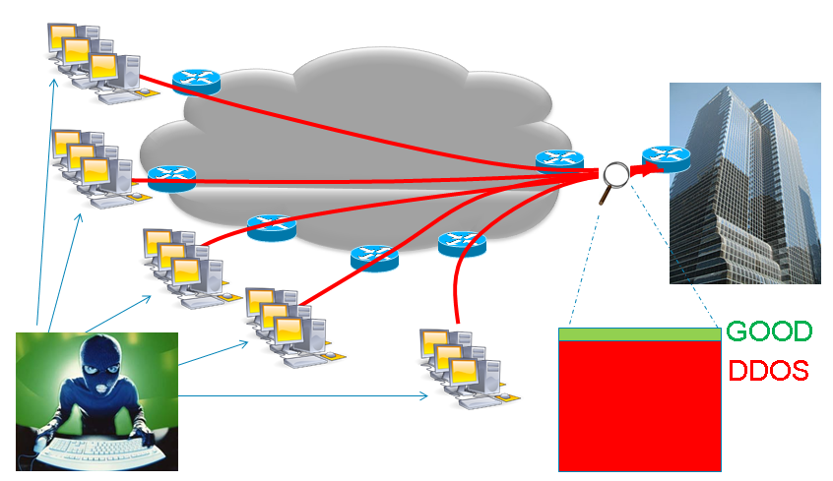
DDOS impact on Customer Business

Slide 6
DDOS impact on customer Business
Enterprise customer can’t defend themselve, when DDoS hit the FW… it’s already too late.
SP could protect enterprise by cleaning DDoS traffic at ingress peering point.
New revenue for SP.
Mandated service to propose to Financial and visible customers.

Slide 7
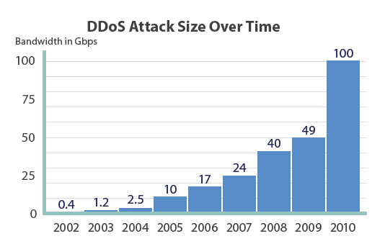
2011 DDoS trends (Nanog source)
Any Internet Operator Can Be a Target for DDoS
  Ideologically-motivated ‘Hacktivism’ and On-line vandalism DDoS attacks are the most commonly identified attack motivations
Size and Scope of Attacks Continue to Grow at an Alarming Pace
  High-bandwidth DDoS attacks are the ‘new normal’ as over 40% of respondents report attacks greater than 1 Gbps and 13% report attacks greater than 10Gbps
  Increased sophistication and complexity of layer-7 DDoS attacks, multi-vector DDoS attacks becoming more common
First-Ever Reports of IPv6 DDoS Attacks 'in the Wild' on Production Networks

Slide 8


DDoS mitigation architecture
1. Detection (no DDoS)
Scan Netflow data
to detect DDOS attacks
DDOS
Analyser
Security Server
Sample Netflow
DDOS
scrubber

Slide 9
DDoS mitigation architecture
2. Detection (DDOS)
Scan Netflow data
Find DDOS signature
DDOS
Analyser
Security Server
Sample Netflow
DDOS
scrubber

Slide 10
DDoS mitigation architecture
3. Redirect traffic to DDOS scruber
Scan Netflow data
Find DDoS signature
DDoS
Analyser
Security Server
BGP DDoS Mitigation
Action: redirect to DDoS scrubber
DDoS
scrubber

Slide 11
DDoS Mitigation: Architecture Considerations
Normal traffic flow when there is no attack
Redirect traffic from any edge PE to any specific DDoS scrubber
  Including the PE that is connected to the host network
Granular (prefix level/network) diversion
  Customers buy DDoS mitigation service for some prefixes
  Pre-provisioned DDoS service for those prefixes (using policy such as standard community flag)
Centralized controller that injects the diversion route
VPN based Labeled return path for the clean traffic
  To prevent routing loops
Solution support redirection of BGP less/more specific prefixes or local originated prefixes (static route, redistributed route)
Support for multi-homed customers
  During attack, send clean traffic from DDOS scrubber to multiple PE’s

Slide 12







The concept
Traffic under normal conditions
Traffic under normalized conditions
Traffic takes shortest path
Upstream and downstream traffic follow traditional routing
ALL interfaces are in the GLOBAL routing table
Server
Scrubber
PE2
Pre-provisioned DDoS instrumentation
Traffic Scrubber
  Separate clean and malicious traffic
Security Analyser
  Analyses Netflow/IPFIX statistics from the traffic flows
Security server
  Actions upon traffic analysis by communication to infrastructure routers
PE3
Security analyser
ISP
Security server
PE1
Internet users

Slide 13
Phase-1: Traditional DDoS mitigation
Traffic under DDoS condition - RTBH
Traffic under DDoS condition
Security analyser detected that the traffic flow is dirty
Security server installs a filter upon ISP ingress router
All (good and malicious) traffic is dropped at network ingress
Operationally simple method
Easy to remove filter if traffic normalizes
Simple to debug and troubleshoot
Server
Scrubber
PE2
PE3
Security analyser
Security server
ISP
PE1
Internet users

Slide 14
Phase-2: BGP based DDoS
Traffic under DDoS condition
Traffic under DDoS condition
Traffic is redirected to a scrubber
Scrubber separates the clean from the malicious traffic
Clean traffic is returned to original destination server
Goal
Do not drop all traffic
Collect traffic intelligence
Operational simplicity
Easy to remove redirect when traffic normalizes
Server
Scrubber
PE2
PE3
Security analyser
Security server
ISP
PE1
Internet users

Slide 15

How does it work?
Normal traffic condition
Internet and VPN
Route-Reflector
All PE’s peer with the RR
All PE’s exchange both Global Internet and VPN prefixes
All PE interfaces are non-VPN
Security analyser is performing doing analyses
5.5.5.5
Server
2.2.2.2
Scrubber
PE2
3.3.3.3
1.1.1.1/32
PE3
Security analyser
ISP
Security server
4.4.4.4
PE1
Destination | Next-hop
1.1.1.1/32 | 2.2.2.2
Internet users

Slide 16
How does it work?
Server is under DDoS
Internet and VPN
Route-Reflector
Flow is detected as dirty by Security analyser
Result: Server is under attack
Traffic needs to be redirected to the scrubber to mitigate the attack
5.5.5.5
Server
2.2.2.2
Scrubber
PE2
3.3.3.3
1.1.1.1/32
PE3
Security analyser
Security server
ISP
4.4.4.4
PE1
Destination | Next-hop
1.1.1.1/32 | 2.2.2.2
Internet users

Slide 17
How does it work?
Server is under DDoS
Internet and VPN
Route-Reflector
DDoS
Route-Reflector
Destination | Next-hop
1.1.1.1/32 | 3.3.3.3
5.5.5.5
5.5.5.5
Server
2.2.2.2
Scrubber
PE2
3.3.3.3
1.1.1.1/32
PE3
DDoS Route-Reflector was pre-visioned
Mitigation route to 1.1.1.1/32 is injected on the DDoS RR by the Security server
Mitigation route to 1.1.1.1/32 is pointing to 3.3.3.3 on DDoS mitigation RR
ISP
Security server
4.4.4.4
PE1
Internet users

Slide 18
How does it work?
Destination | Next-hop
1.1.1.1/32 | 3.3.3.3
Server is under DDoS
Internet and VPN
Route-Reflector
DDoS
Route-Reflector
Mitigation route to 1.1.1.1/32 is pointing to 3.3.3.3 is signalled to all PE’s
All PE’s receive the mitigation route from the DDoS Mitigation RR
Each PE will now have 2 routes to reach 1.1.1.1/32
Which route will the PE use?
5.5.5.5
5.5.5.5
Server
2.2.2.2
Scrubber
PE2
3.3.3.3
1.1.1.1/32
PE3
ISP
Security server
4.4.4.4
PE1
BGP Table
Routing Table
Destination | Next-hop
1.1.1.1/32 | 2.2.2.2
1.1.1.1/32 | 3.3.3.3
Destination | Next-hop
1.1.1.1/32 | ????????????
Internet users

Slide 19
How does it work?
Server is under DDoS
Trick # 1
The DDoS mitigation route will ALWAYS be preferred, even if
  Both prefix lengths are the same
  DDoS prefix is shorter
  Original prefix has better administrative distance
Internet and VPN
Route-Reflector
DDoS
Route-Reflector
5.5.5.5
5.5.5.5
Server
2.2.2.2
Scrubber
PE2
3.3.3.3
1.1.1.1/32
PE3
ISP
Security server
4.4.4.4
PE1
BGP Table
Routing Table
Destination | Next-hop
1.1.1.1/32 | 2.2.2.2
1.1.1.1/32 | 3.3.3.3
Destination | Next-hop
1.1.1.1/32 | 3.3.3.3
Internet users

Slide 20
How does it work?
Server is under DDoS
The mitigated traffic flows towards PE3 (3.3.3.3)
PE3 is sending the dirty flow towards the scrubber
The scrubber will
  Handle and remove the dirty traffic within the original flow
  Send the cleaned traffic towards the original destination (1.1.1.1 at PE2 (2.2.2.2))
Internet and VPN
Route-Reflector
DDoS
Route-Reflector
5.5.5.5
5.5.5.5
Clean traffic
Server
2.2.2.2
Scrubber
PE2
3.3.3.3
1.1.1.1/32
PE3
ISP
4.4.4.4
PE1
BGP Table
Routing Table
Destination | Next-hop
1.1.1.1/32 | 2.2.2.2
1.1.1.1/32 | 3.3.3.3
Destination | Next-hop
1.1.1.1/32 | 3.3.3.3
Internet users

Slide 21
How does it work?
Problem
Scrubber sends traffic to PE3
PE3 does routing lookup for 1.1.1.1 and finds that it is directly attached
ROUTING LOOP!!!
How do we fix this?
  Often this is fixed with true routing clutches:
    Back-to-back cables
    L2-VPN’s
    Manual tunnels
    Etc… (all operational hard to maintain)
  Better to use a new isolated dynamic routing table for the clean traffic
  Pre-provision this Clean table
Server is under DDoS
Internet and VPN
Route-Reflector
DDoS
Route-Reflector
5.5.5.5
5.5.5.5
Clean traffic
Server
2.2.2.2
Scrubber
PE2
3.3.3.3
1.1.1.1/32
PE3
ISP
4.4.4.4
PE1
BGP Table
Routing Table
Destination | Next-hop
1.1.1.1/32 | 2.2.2.2
1.1.1.1/32 | 3.3.3.3
Destination | Next-hop
1.1.1.1/32 | 3.3.3.3
Internet users

Slide 22
How does it work?
Server is under DDoS
The clean traffic will be injected upon PE3 on an interface member of VPN Clean
PE3 will now do a routing destination lookup for 1.1.1.1 in VPN Clean
The matching routing table entry is pointing towards PE2 at 2.2.2.2
The clean flow, which is now part of VPN Clean is sent towards PE2 reachable at 2.2.2.2
Server
2.2.2.2
Scrubber
PE2
3.3.3.3
1.1.1.1/32
PE3
ISP
4.4.4.4
PE1
BGP Table
Routing Table
Destination | Next-hop
1.1.1.1/32 | 2.2.2.2
1.1.1.1/32 | 3.3.3.3
Destination | Next-hop | VPN
1.1.1.1/32 | 3.3.3.3 | Global
1.1.1.1/32 | 2.2.2.2 | Clean
Internet users
VPN Clean

Slide 23
How does it work?
Server is under DDoS
Routing Table
PE2 receives the clean flow within VPN clean
PE2 does a destination address routing lookup in VPN clean
A matching route is found in VPN clean
Flow is forwarded towards CE1 onwards to Server
Destination | Next-hop | VPN
1.1.1.1/32 | 3.3.3.3 | Global
1.1.1.1/32 | CE1 | Clean
Server
2.2.2.2
Scrubber
PE2
3.3.3.3
CE1
1.1.1.1/32
PE3
ISP
HOLD on a minute!
PE2 does not have any interface part of VPN clean
All interfaces on PE2 are global interfaces
so how did that clean route for 1.1.1.1 get into VPN clean?
4.4.4.4
PE1
Internet users

Slide 24
How does it work?
Server is under DDoS
BGP Table
Routing Table
Destination | Next-hop | VPN
1.1.1.1/32 | CE1 | Global
1.1.1.1/32 | 3.3.3.3 | Global
1.1.1.1 | CE1 | clean
Destination | Next-hop | VPN
1.1.1.1/32 | 3.3.3.3 | Global
1.1.1.1/32 | CE1 | Clean
Trick # 2
Copy the locally BGP inserted route directly into VPN clean BGP table
Neighbour details are inherited from the global table (i.e.)
  Outgoing interface
  Next-hop
Interface pointing towards CE1 is NOT VPN aware
This VPN clean distributed as normal VPN
New CLI command to do that
  import from default-vrf route-policy ddos advertise-as-vpn
Server
2.2.2.2
Scrubber
PE2
3.3.3.3
CE1
1.1.1.1/32
PE3
ISP
4.4.4.4
PE1
Internet users

Slide 25
Going back to traditional traffic flow
DDoS attack has ended
Destination | Next-hop
1.1.1.1/32 | 3.3.3.3
Internet and VPN
Route-Reflector
DDoS
Route-Reflector
5.5.5.5
5.5.5.5
Server
2.2.2.2
Scrubber
Remove the routing entry on the Mitigation DDoS RR
No more route is remaining on the DDoS Mitigation RR
Traffic flows normally again
3.3.3.3
1.1.1.1/32
ISP
Security server
4.4.4.4
PE1
Internet users

Slide 26
Why injecting DDoS in separate BGP instance ?
Solution support redirection of BGP less/more specific prefixes or local originated prefixes (static route, redistributed route)
Indepenant Inter-Domain control plane and DDoS plane
  No need to withdraw and re-signal Inter-Domain prefixes, keep internet route intacts in control plane.
  Easy to troubleshoot

Slide 27
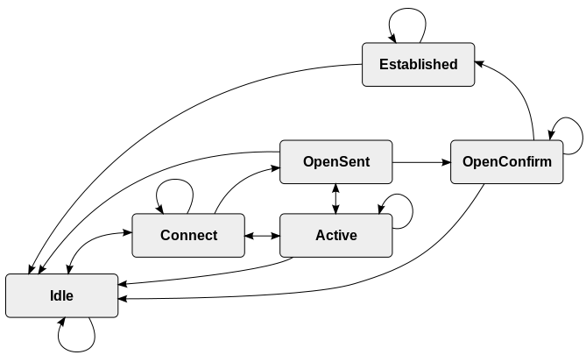
Any Questions?

Slide 29
Backup Slides
Technical details

Slide 30
Configuration (1)
Creation of DDoS BGP instance
router bgp 99 instance ddos
bgp router-id 3.3.3.3
bgp read-only
bgp install diversion
address-family ipv4 unicast
!
router bgp 99
bgp router-id 2.2.2.2
address-family ipv4 unicast
!
Allows config of 2th IPv4 or IPv6 instance
Suppresses BGP Update Generation
Triggers BGP ddos instance to install diversion path to RIB, so that the paths are pushed down to FIB

Slide 31
Configuration (2)
Importing the global route’s in the clean VRF
vrf clean
address-family ipv4 unicast
import from default-vrf route-policy ddos advertise-as-vpn
export route-target
111:1
!
!
address-family ipv6 unicast
import from default-vrf route-policy ddos advertise-as-vpn
export route-target
111:1
!
!
!

Slide 32
“show” commands
RP/0/0/CPU0:hydra-prp-A#show route
Codes: C - connected, S - static, R - RIP, B - BGP, (>) - Diversion path
D - EIGRP, EX - EIGRP external, O - OSPF, IA - OSPF inter area
N1 - OSPF NSSA external type 1, N2 - OSPF NSSA external type 2
E1 - OSPF external type 1, E2 - OSPF external type 2, E - EGP
i - ISIS, L1 - IS-IS level-1, L2 - IS-IS level-2
ia - IS-IS inter area, su - IS-IS summary null, * - candidate default
U - per-user static route, o - ODR, L - local, G - DAGR
A - access/subscriber, a - Application route, (!) - FRR Backup path
Gateway of last resort is not set
O 1.0.11.0/24 [110/2] via 13.0.3.1, 00:36:19, GigabitEthernet0/2/1/5
O 1.1.1.1/32 [110/2] via 13.0.3.1, 00:36:19, GigabitEthernet0/2/1/5
L 2.2.2.2/32 is directly connected, 00:37:24, Loopback0
O 3.3.3.3/32 [110/2] via 87.0.1.2, 00:36:19, GigabitEthernet0/2/1/9
O 4.4.4.4/32 [110/3] via 13.0.3.1, 00:36:19, GigabitEthernet0/2/1/5
[110/3] via 87.0.1.2, 00:36:19, GigabitEthernet0/2/1/9
B 5.5.5.5/32 [200/0] via 1.1.1.1, 00:34:22
B > [200/0] via 123.0.0.2, 00:34:22
[...]

Slide 33
“show” commands (1)
RP/0/0/CPU0:hydra-prp-A#show route
Codes: C - connected, S - static, R - RIP, B - BGP, (>) - Diversion path
D - EIGRP, EX - EIGRP external, O - OSPF, IA - OSPF inter area
N1 - OSPF NSSA external type 1, N2 - OSPF NSSA external type 2
E1 - OSPF external type 1, E2 - OSPF external type 2, E - EGP
i - ISIS, L1 - IS-IS level-1, L2 - IS-IS level-2
ia - IS-IS inter area, su - IS-IS summary null, * - candidate default
U - per-user static route, o - ODR, L - local, G - DAGR
A - access/subscriber, a - Application route, (!) - FRR Backup path
Gateway of last resort is not set
O 1.0.11.0/24 [110/2] via 13.0.3.1, 00:36:19, GigabitEthernet0/2/1/5
O 1.1.1.1/32 [110/2] via 13.0.3.1, 00:36:19, GigabitEthernet0/2/1/5
L 2.2.2.2/32 is directly connected, 00:37:24, Loopback0
O 3.3.3.3/32 [110/2] via 87.0.1.2, 00:36:19, GigabitEthernet0/2/1/9
O 4.4.4.4/32 [110/3] via 13.0.3.1, 00:36:19, GigabitEthernet0/2/1/5
[110/3] via 87.0.1.2, 00:36:19, GigabitEthernet0/2/1/9
B 5.5.5.5/32 [200/0] via 1.1.1.1, 00:34:22
B > [200/0] via 123.0.0.2, 00:34:22
[...]

Slide 34
“show” commands (2)
RP/0/0/CPU0:hydra-prp-A#show route 5.5.5.5/32
Routing entry for 5.5.5.5/32
Known via "bgp 2394-ro", distance 200, metric 0, type internal
Installed Feb 19 22:56:45.896 for 00:34:33
Routing Descriptor Blocks
1.1.1.1, from 1.1.1.1
Route metric is 0
123.0.0.2, from 101.0.0.4, Diversion Path (bgp)
Route metric is 0
No advertising protos.
RP/0/0/CPU0:hydra-prp-A#show cef 5.5.5.5/32 det
5.5.5.5/32, version 60652, internal 0x14000001 (ptr 0xaf6e3840) [1], 0x0 (0x0), 0x0 (0x0)
Updated Feb 19 22:56:46.723
local adjacency 87.0.1.2
Prefix Len 32, traffic index 0, precedence n/a, priority 4
gateway array (0xae07a310) reference count 2, flags 0x8020, source rib (5), 0 backups
[1 type 3 flags 0xd0141 (0xae10f8c0) ext 0x420 (0xaec261e0)]
LW-LDI[type=0, refc=0, ptr=0x0, sh-ldi=0x0]
via 123.0.0.2, 2 dependencies, recursive [flags 0x6000]
path-idx 0 [0xaf6e3c00 0x0]
next hop 123.0.0.2 via 123.0.0.0/24
Load distribution: 0 (refcount 1)
Hash OK Interface Address
0 Y GigabitEthernet0/2/1/9 87.0.1.2

Slide 35
“show” commands (3)
RP/0/0/CPU0:hydra-prp-A# show route 123.0.0.2
Routing entry for 123.0.0.0/24
Known via "ospf 100", distance 110, metric 2, type intra area
Installed Feb 19 22:54:48.363 for 00:39:01
Routing Descriptor Blocks
87.0.1.2, from 3.3.3.3, via GigabitEthernet0/2/1/9
Route metric is 2
No advertising protos.
RP/0/0/CPU0:hydra-prp-A#
RP/0/0/CPU0:hydra-prp-A#show route 1.1.1.1
Routing entry for 1.1.1.1/32
Known via "ospf 100", distance 110, metric 2, type intra area
Installed Feb 19 22:54:49.259 for 00:49:20
Routing Descriptor Blocks
13.0.3.1, from 1.1.1.1, via GigabitEthernet0/2/1/5
Route metric is 2
No advertising protos.

Slide 36
Thank You

